Slide 1


Slide 2

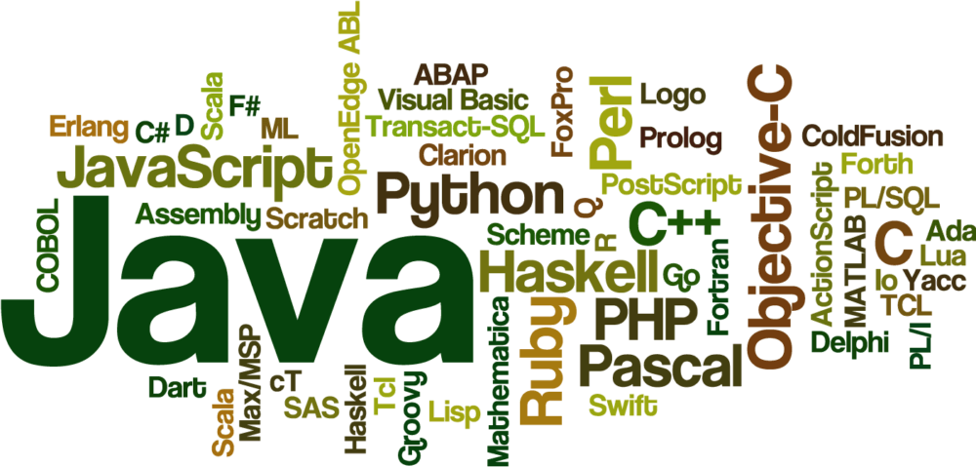


Slide 3



LIST INTERFACE
IN
JAVA

Slide 4
CORE-COLLECTION LIST
Collection — the root of the collection hierarchy
A collection represents a group of objects known as its elements
Set — a collection that cannot contain duplicate elements
List — an ordered collection (sometimes called a sequence)
Map — an object that maps keys to values
A Map cannot contain duplicate keys; each key can map to at most one value

Slide 5
LIST –INTERFACE
An ordered collection (also known as a sequence)
The user of this interface has precise control over where in the list each element is inserted
The user can access elements by their integer index (position in the list), and search for elements in the list
The List interface provides two methods to search for a specified object

Slide 6
LIST INTERFACE OPERATIONS
Positional access — manipulates elements based on their numerical position in the list. This includes methods such as get, set, add, addAll, and remove
Search — searches for a specified object in the list and returns its numerical position. Search methods include indexOf and lastIndexOf
Iteration — extends Iterator semantics to take advantage of the list's sequential nature

Slide 7
NOTE
Some list implementations have restrictions on the elements that they may contain
Attempting to add an ineligible element throws an unchecked exception, typically NullPointerException or ClassCastException
Attempting to query the presence of an ineligible element may throw an exception, or it may simply return false

Slide 8

THANK YOU

